Slide 1
What do you need?

Slide 2
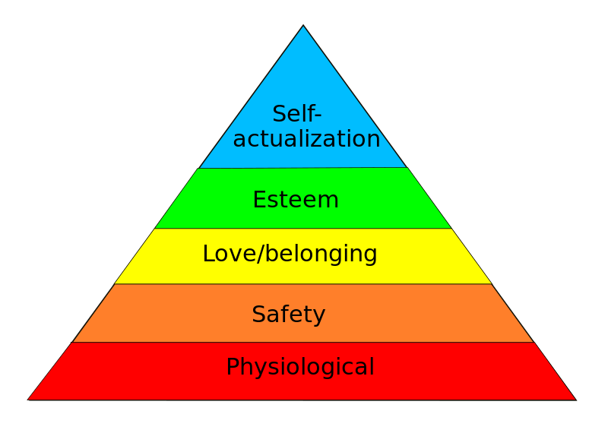
What are human needs?
People who rise above the other needs have found a ‘cause, vocation, calling.’
(A Maslow 1966)
Notes:
Where are you concentrating your efforts and energy?

Slide 3
I Timothy 6:6-10
⁶ Now godliness with contentment is great gain. ⁷ For we brought nothing into this world, and it is certain we can carry nothing out. ⁸ And having food and clothing, with these we shall be content.

Slide 4
I. What do we need in life to be content?
Food & Clothing I Tim 6:8 And having food and clothing, with these we shall be content.
What you have Heb 13:5 Let your conduct be without covetousness; and be content with such things as you have: for he has said, I will never leave you, nor forsake you. (Phil 4:19 – NEEDS!)
Whatever happens to you Phil 4:11 … I have learned, in whatsoever state I am, therewith to be content. 12 I know both how to be abased, and I know how to abound: everywhere and in all things I am instructed both to be full and to be hungry, both to abound and to suffer need. 13 I can do all things through Christ who strengthens me.
Notes:
Contentment with what we have is power. We cannot be bought, bribed, distracted, or side tracked

Slide 5
II. What do we need for a successful life?
Verse 6 Now godliness with contentment is great gain.
Godliness
Contentment
Notes:
Contentment with what we have is power. We cannot be bought, bribed, distracted, or side tracked

Slide 6
Godliness is a mystery & part of our calling
I Tim 3:16
And without controversy great is the mystery of godliness:
​​God was manifested in the flesh,
​​Justified in the Spirit,
​​Seen by angels,
​​Preached among the Gentiles,
​​Believed on in the world,
​​Received up in glory.
Jesus is perfect in godliness. We must grow in Christ likeness. So practical godliness is Christ likeness
Jesus!
Notes:
Godliness for us means living like Christ – Kingdom focused, purposeful living even above personal needs.

Slide 7
III. What happens without godliness and contentment?
Clayton Alderfer (Existence, Relatedness and Growth) ’When needs in a higher category are not met then individuals make more effort in a lower category need in the hopes of achieving the higher need.’
Covetousness is the opposite of contentment Heb 13:5 Let your conduct be without covetousness; and be content…
Discontent in life can lead to misplaced priorities and a wasted life
Those who desire to be rich will …
Notes:
Neighbour – dedicated to the good life!

Slide 8
I Timothy 6:6-10
9. But those who desire to be rich fall into temptation and a snare, and into many foolish and harmful lusts which drown men in destruction and perdition. 10. For the love of money is a root of all kinds of evil, for which some have strayed from the faith in their greediness, and pierced themselves through with many sorrows.
11. But you, O man of God, flee these things and…
temptation and a snare
foolish and harmful lusts
drown men
strayed from the faith
pierced themselves through with many sorrows
Notes:
Greatest temptation is the one the devil offers – independence!!!!

Slide 9
DISCONTENT IS THE CATALYST FOR CHANGE
Notes:
I am discontent with how I am so far (though content with what I have)

Slide 10
The Conclusion
How contented are you with what you have?
Godliness with contentment is great gain
How contented are you with who you are?
Have you found your purpose?
Loving God & accomplishing His perfect will for you
Is your life an example of Godliness and contentment?
What’s your goal in life?

Slide 11
Theme for 2014 GO & MAKE DISCIPLES
LIVE contentedly with godliness (the life of a disciple) then
PASS it on (make disciples!)

